Slide 1
Group 20
Training Simulator for Soccer Players
And
Water Quality and Flood Forecast Simulator
Dhaval Patel, Kruneet Patel,
Charvi Virani, and Michael Gallagher

Slide 2
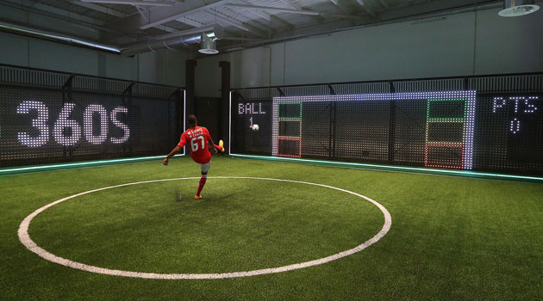
Training Simulator for Soccer Players

Slide 3
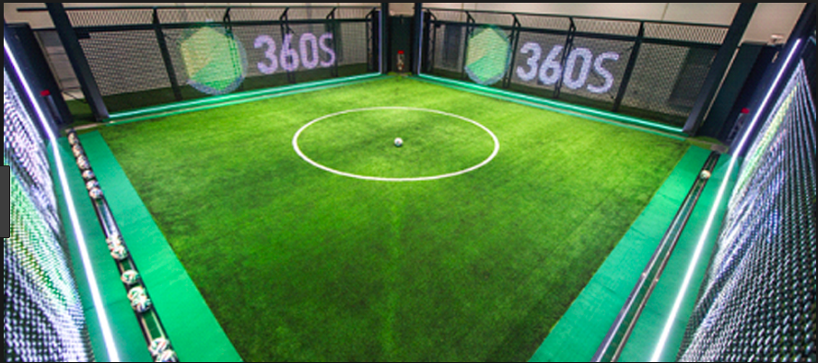
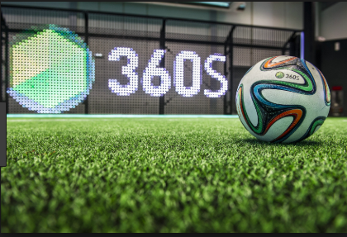
Motivations
Create a better simulator for soccer training than video games such as FIFA or PES ( Pro Evolution Soccer).
This product is useful for both professional and beginner players who are new to soccer giving them a way to track their stats and use the data to improve their soccer skills.
Gives teams a training system that they can use all year round and is less likely to cause injury

Slide 4
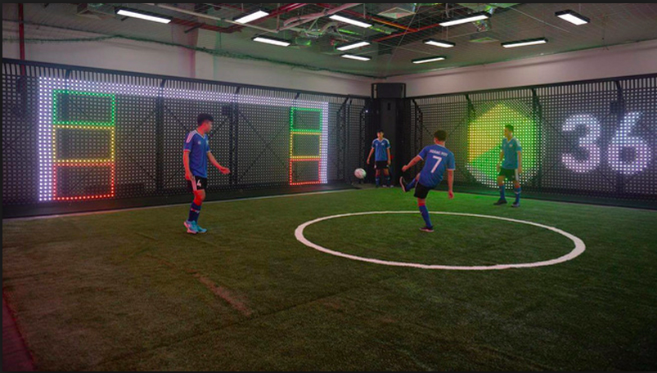
Project Description
System consists of a 4-sided physical box that encloses an artificial pitch. Once activated, the simulator fires in balls to a waiting player, who is then directed to settle and pass that ball into a specific quadrant of the box, dribble around physical obstacles, shoot at virtual goalkeepers, etc.
System relies on an LED wall and automated 'ball boy', using fully-customisable system software to analyse performance and allow players to work on their skills.

Slide 5
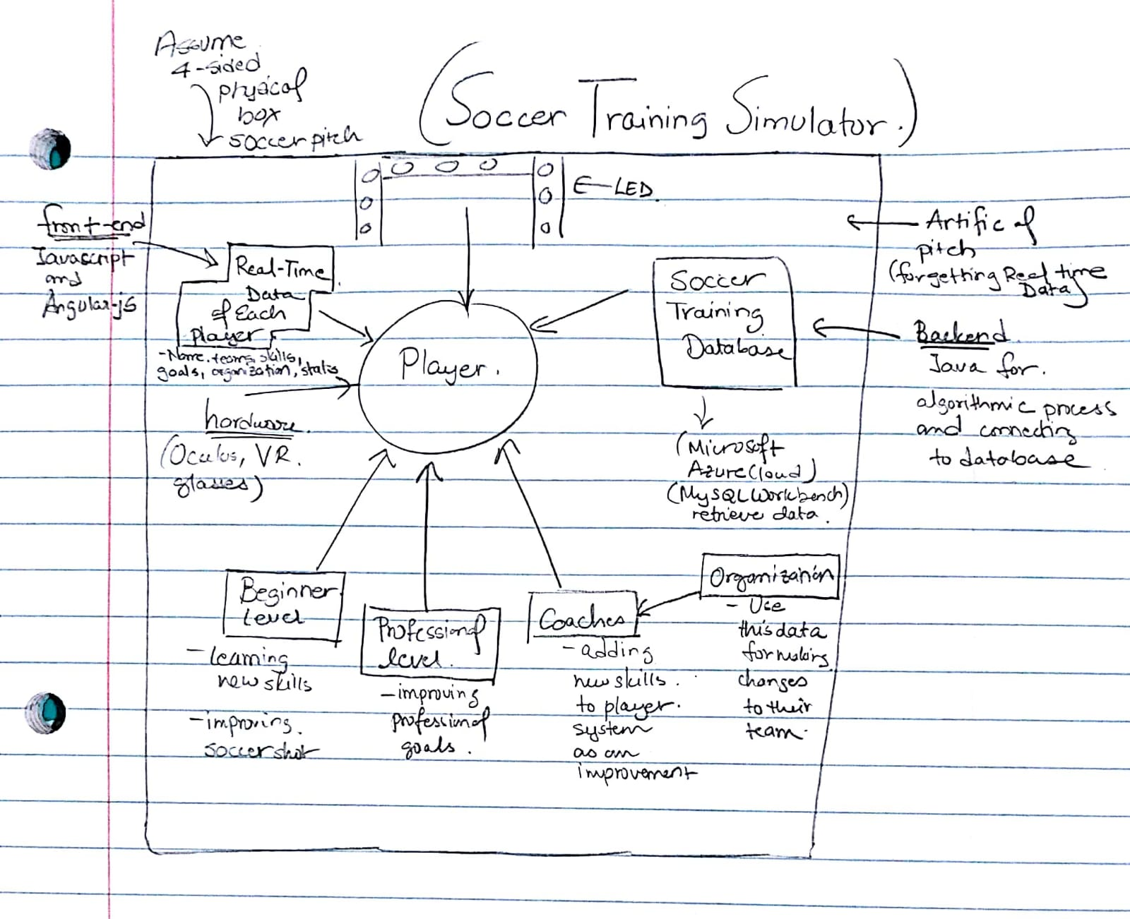
Soccer Training Simulator Brainstorming Design

Slide 6
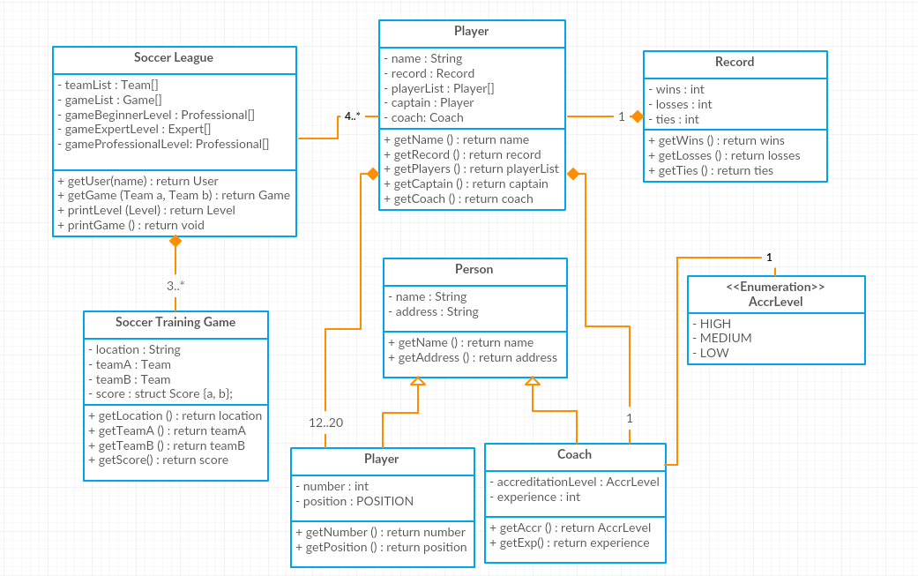
Soccer Training Simulator UML Diagram

Slide 7
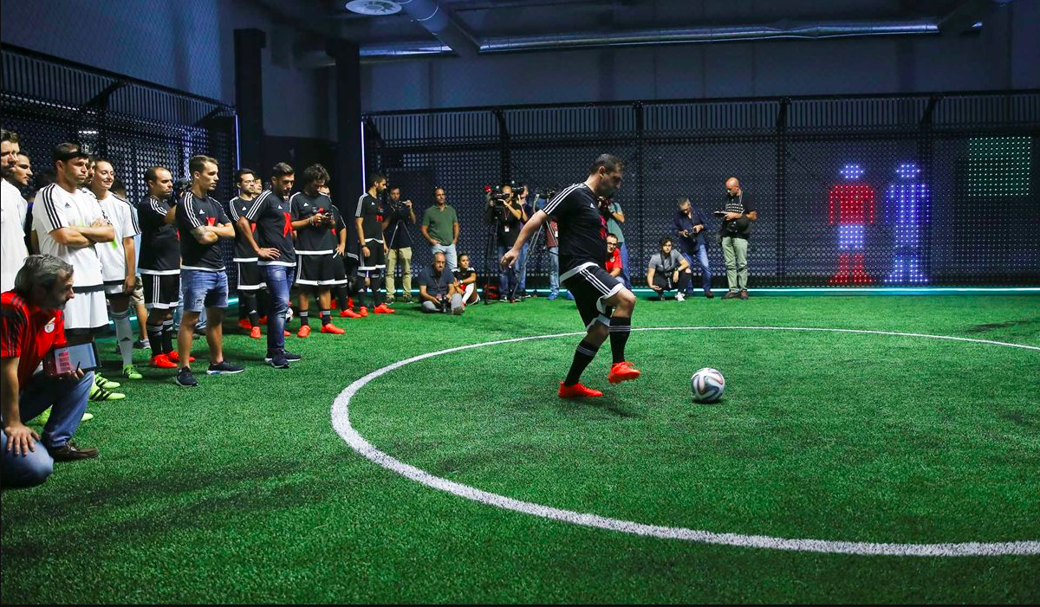
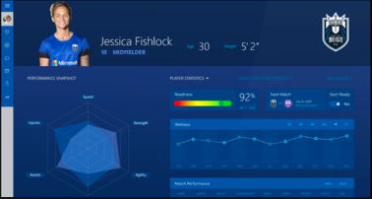
Track Real Time Player’s Data
The software will have the ability to interact with existing databases and manage training sessions.
Each player has their own system profile for training enabling them to track details about their session and generate reports.

Slide 8
Water Quality and Flood Forecast Simulator
Project Description:
The software system aims to detect and maintain water quality for supply management from natural water sources as well as overhead detection of floods. It’s function is ‘water purification and detection’ and ‘monitoring the flood and forecasting’.
For this it will take data readings of certain key factors like dissolved oxygen level, temperature, pH, radiochemical and stable isotope analysis, conductivity, etc. from the water flow continuously across the state.
These readings will be collected from multiple sensors and collected in a single <<Interface>> sensor. After validation, this data will stored in a database to ensure the users see accurate values.
The system also tries to analyse the past weather data along with some critical factors like the temperature change in the surrounding terrain of the water body to predict the future water level and send out accurate flood warnings in advance.

Slide 9
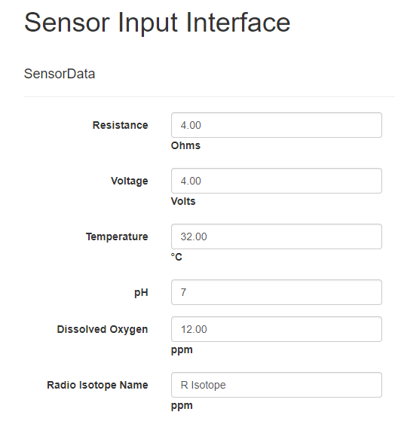
Sensor Interface
Sensors
Since we don’t actually have sensors to fetch input data, we simulate sensor input by having admin user input.
This mock sensor data is validated by the sensor interface. If validation successful, then data passes to the database. If validation fails more than the threshold amount of times, then “sensor failure” alert is sent to the concerned parties. Interface turns that sensor ‘offline’.

Slide 10
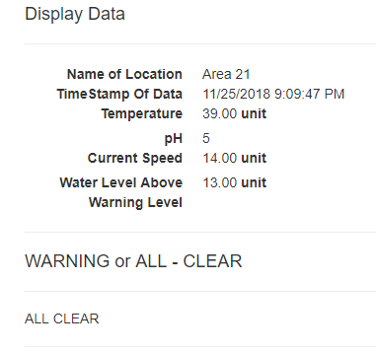
Public User Interface
Public User
User inputs location using Map. System fetches latest data to be displayed to public user according to the input location.
System warns user for flood warning according to the data retrieved.

Slide 11
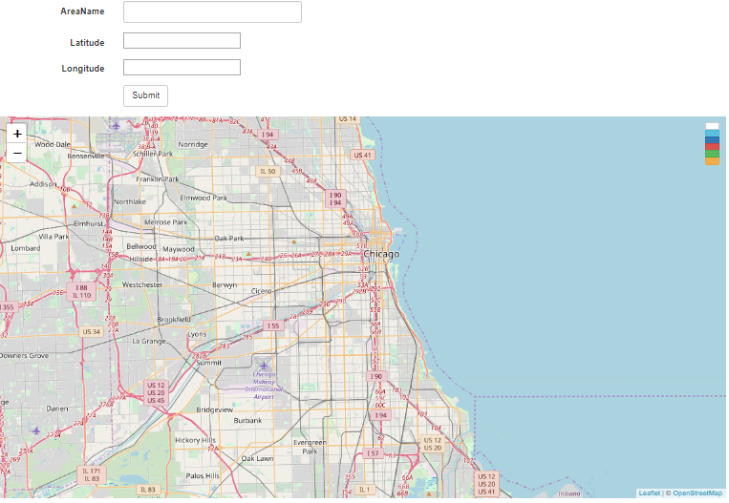
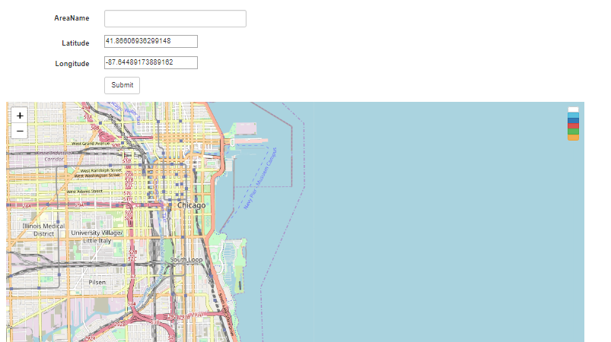
Map API

Slide 12
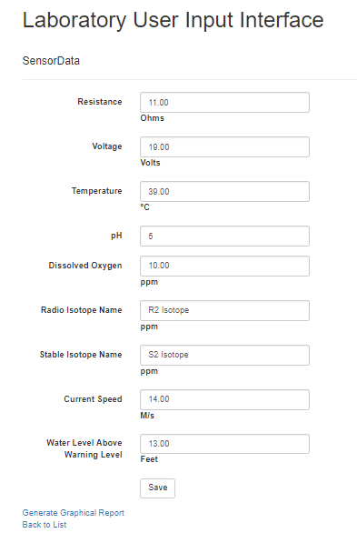
Laboratory User Interface
Laboratory User
User inputs location using Map. System fetches latest data to be displayed to laboratory user according to the input location. Lab user can update the information and click submit. Then information is validated. If validation successful, then data passes to the database
User has choice whether to generate report. Report generated has the parameter comparison chart.

Slide 13
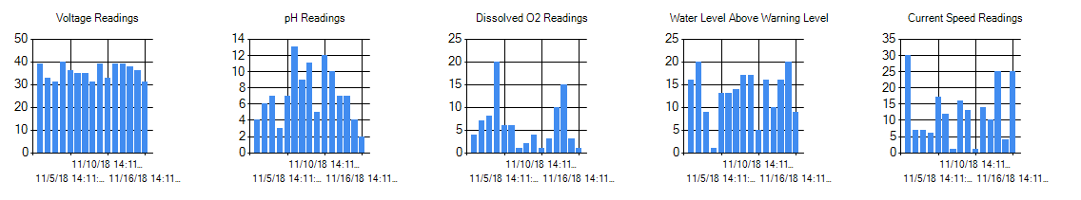
Graphical Report Generation
A graphical report of each reading is generated for the user when selected. The graphs contain historical data stored in the database and the current readings.

